Slide 1
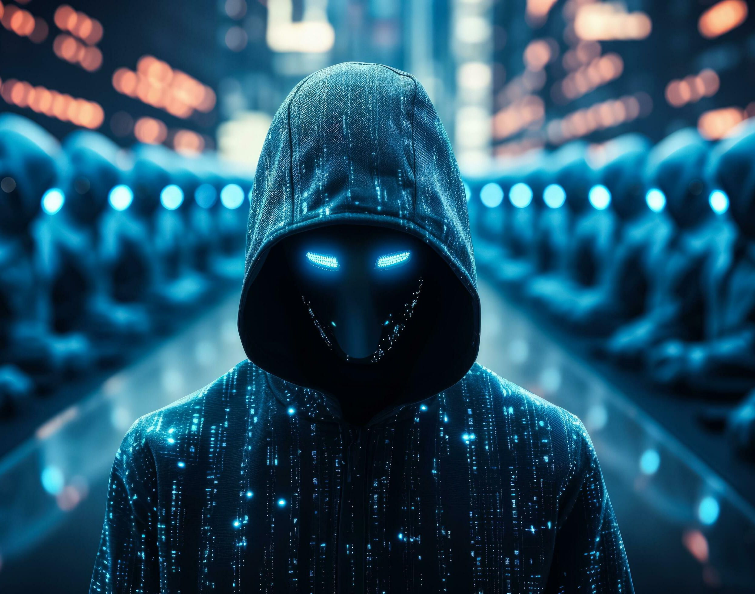
Cyber Security Threat Model
E-Commerce – PF
April 2025

Slide 2
Executive Summary
Low
Risk
Cyber Security Threat Model Sensitive

Slide 3
Threat Model Details
Entity Under Review
Name
E-Commerce – People First
Description
The new e-commerce MHR website allows customers to purchase People First licenses through a self-service platform. It streamlines the process by capturing customer details, processing payments via Stripe, and integrating with Salesforce to create and update sales records. This enables automated onboarding, accurate opportunity tracking, and environment provisioning upon successful purchase.
Risk Impact
Critical
Feasibility of obtaining PF environments cheaper or at no cost.
Scope
The threat model reviews MHR's e-commerce platform and ability to make software purchases and integration with Stripe and Salesforce
Key Stakeholders
Kathryn Brook
Head of Business Transformation
Peter Luk
Principal .Net Engineer
Michael Dyer
Salesforce Developer
Quality Assurance
Security Consultant
David Biayna Neal
14/04/2025
Security Review Meeting
Trefor Walters, Will North
14/04/2025
Approved by
Will North
14/04/2025
Cyber Security Threat Model Sensitive

Slide 4


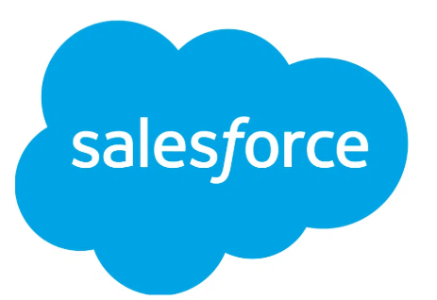
Threat Model
Versantus – Website Host
Stripe – Payment Provider
3. Website sends price and packages to Stripe which handles the payment.
API - Webhook
MHR E-Commerce Website
T02
Stripe
4. Once payment received via Stripe successfully, it sends an update back to the website.
1. Customer accesses website, chooses package and completes contact info, accepts T&C and completes checkout
2. A new Salesforce record at prospect level is created with an opportunity attached. This is sent via an API from E-Commerce Webpage to SF .
T01
MHR
API
5. Confirmation sent to Salesforce record, updates to Closed- Won.
Customer
6. Closed - Won Trigger in SF triggers all emails including environment creation.
Cyber Security Threat Model Sensitive

Slide 5
Mitigating Controls
Threat Ref. | Threat Description | Control Design | Control Owner | Control Mitigation Effectiveness | Threat Mitigation
T01 | A malicious actor could attempt to exploit the API by obtaining unauthorized access to Salesforce through the Connected App. If the consumer key and secret for OAuth authentication were compromised, the attacker could potentially impersonate the e-commerce platform and manipulate Salesforce records or access sensitive data. | The control in place to mitigate the risk involves using OAuth 2.0 authentication with a consumer key and secret, which are generated automatically when the Connected App is created. The API user—dedicated solely for API access and without login privileges is assigned only the necessary permissions for commerce-related tasks. Additionally, system administrators are the only individuals with access to the API credentials in Salesforce, ensuring that the risk of unauthorized access is minimized. | Salesforce Team | Effective | Sufficient Mitigation
T02 | A malicious actor is able to capture a request from the e-commerce website and change the transaction to be able to obtain cheaper or free PF files and environments. | Security tested and fixed controls to ensure a malicious actor can't obtain the product at zero cost. | PF engineering | Ineffective | Sufficient Mitigation
Cyber Security Threat Model Sensitive

Slide 6
Control Weaknesses
Action Ref. | Control Weakness | Threat | Recommendation
A02 |  | A malicious actor is able to capture a request from the e-commerce website and change the transaction to be able to obtain cheaper or free PF files and environments.
Cyber Security Threat Model Sensitive

